Slide 1
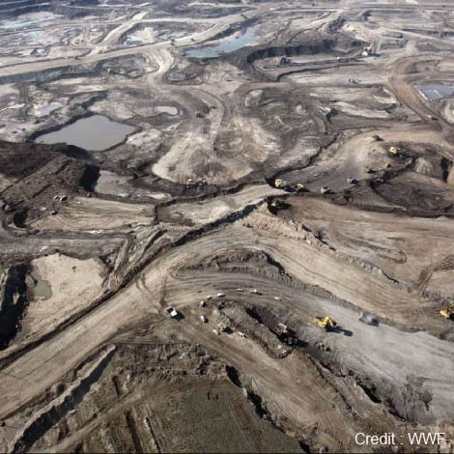
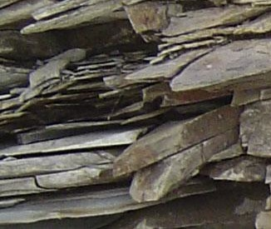
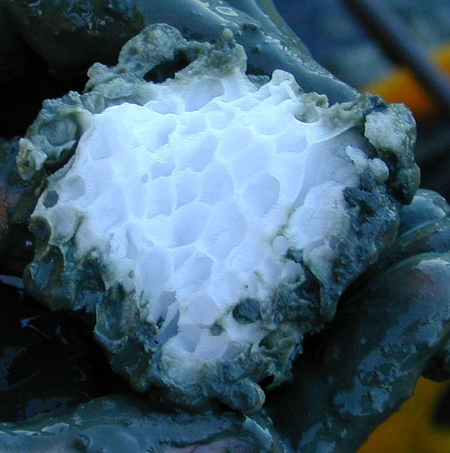
Unconventional Sources of Oil & Gas
Oil Sands and Heavy Oil
Shale Oil
Shale Gas
Oil Shale Gas
Methane Clathrates
EG5066 Energy Technologies: current issues & future directions

Slide 2

Unconventional Sources of Oil & Gas
Conventional Reservoirs
Small volumes that are easy to develop
Improved technology
High-Medium
Quality
Increased pricing
Unconventional
Large volumes that are difficult to develop
Low Perm
Oil
Tight Gas
Sands
Gas
Shales
Heavy
Oil
Coalbed
Methane
Gas Hydrates
Oil Shale
EG5066 Energy Technologies: current issues & future directions

Slide 3
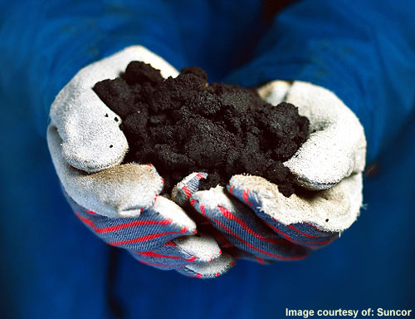
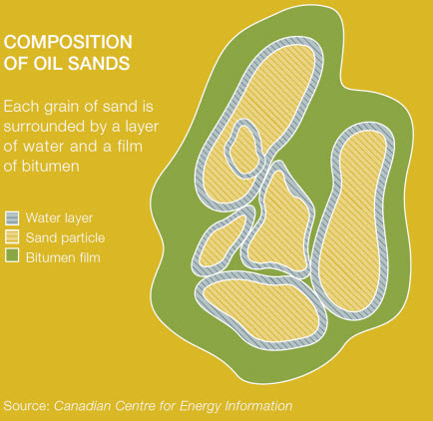
Oil Sands
Sand grains coated by water and clay, with bitumen, an especially heavy, viscous crude oil, filling the intervening pore spaces
API <10º
16 major deposits around the world.
Two biggest:
Athabasca, in Alberta, Canada (Tar sands - bitumen)
Orinoco Oil Belt, Venezuela (Extra-heavy oil)
Others:
Kazakhstan 42 billion barrels
Russia 28.4 billion barrels
EG5066 Energy Technologies: current issues & future directions

Slide 4
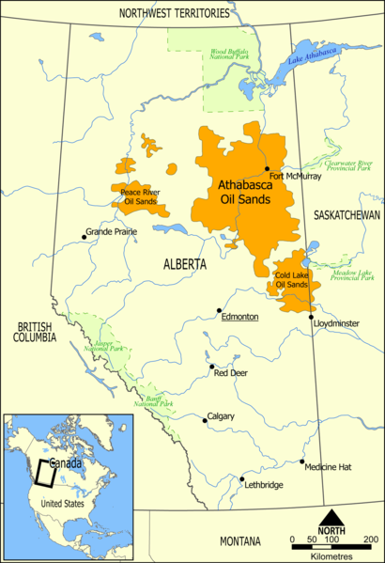
Athabasca Oil Sands
Used by Cree Indians for waterproofing their canoes
First “western” discovery in 1848
Commercial production started 1967
Athabasca + Peace River + Cold lake deposits
1/3 known global oil reserves
141,000 km² in extent
Reserves of 1.7 to 2.5 trillion barrels of bitumen
10 - 15% recoverable
Only reserves suitable for large scale surface mining
Most can be recovered using in-situ methods
Alberta oil sands
10 – 12% bitumen
80 – 85% mineral material
4 – 6% water
EG5066 Energy Technologies: current issues & future directions

Slide 5
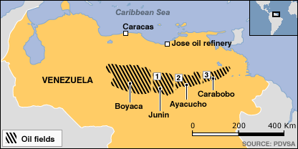
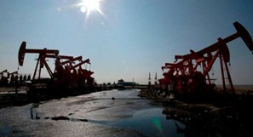
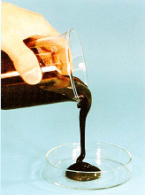
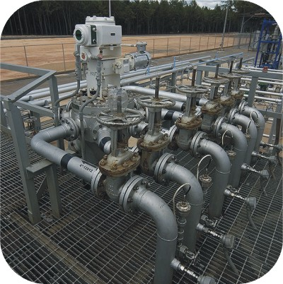
Orinoco Oil Belt, Venezuela
Orinoco Oil Belt – Eastern Venezuelan basin
Reserves of 1200 billion barrels
Of which 513 billion barrels recoverable
Number of projects involved
Natural bitumen (7.5º – 8.5º API) extracted from reservoir
Emulsified with water to give Orimulsion
70% bitumen
30% water
<1% surfactants
Orimulsion used as fuel oil in boilers
EG5066 Energy Technologies: current issues & future directions

Slide 6
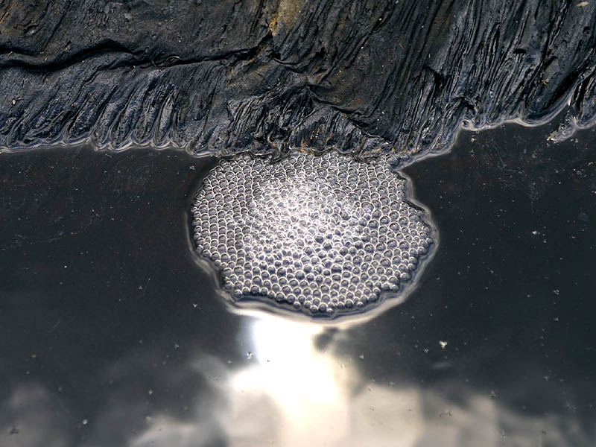
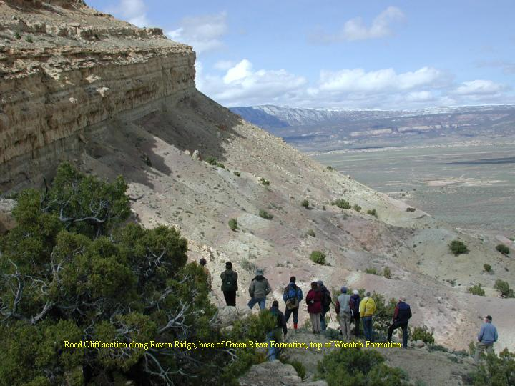
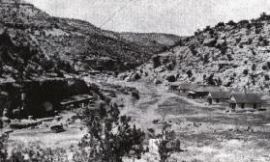
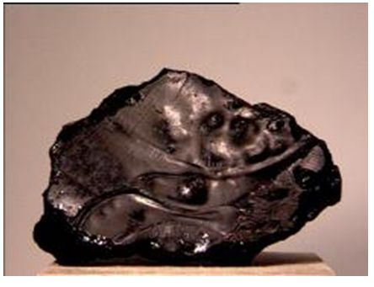

Other main sources
Trinidad and Tobago
Pitch Lake at La Brea
Semi-solid emulsion of soluble bitumen, mineral matter & water
Used as road surfacing since 1815
Reserves of 10 million tonnes
USA
Distillation of tar sands started in California in 1870s
Gilsonite (a naturally occurring solid hydrocarbon) found in eastern Utah – Green River Formation
Used for printing inks, paints, protective coatings
EG5066 Energy Technologies: current issues & future directions

Slide 7
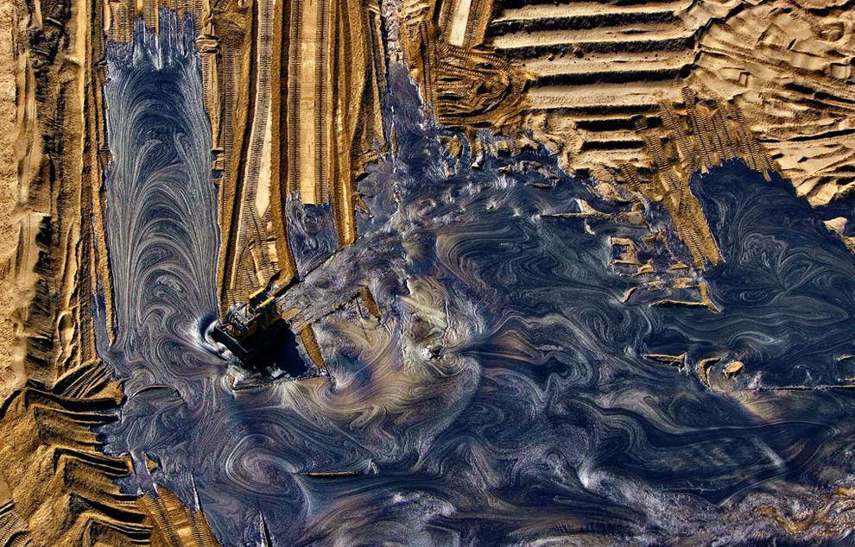
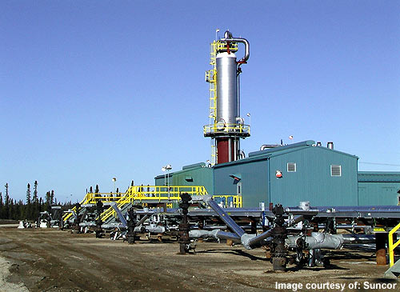
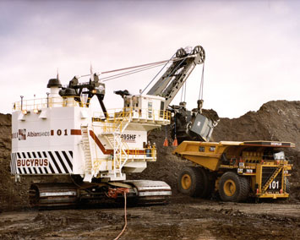
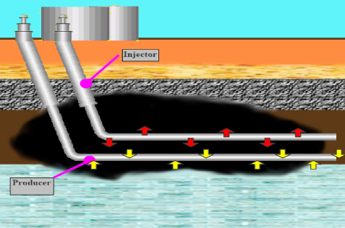
Oil sands - extraction
Traditional surface mining
In-situ methods
EG5066 Energy Technologies: current issues & future directions

Slide 8
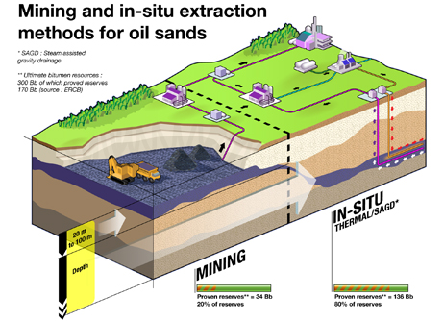
Oil Sands
Traditional surface mining
Giant shovels excavate bitumen to depth of around 75m
Bitumen separated or “cracked” from its sedimentary matrix by the addition of hot water, mechanical agitation and skimming
Uses process developed by Clark in 1920s
2 tonnes of oil sand gives 1 barrel of oil (0.125 t)
EG5066 Energy Technologies: current issues & future directions

Slide 9
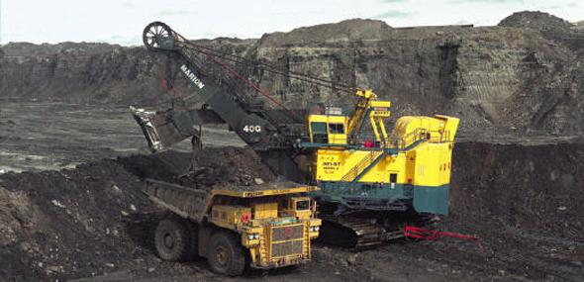
Oil Sands
Clark Hot Water Extraction (CHWE) process
Ores mined using open-pit mining technology
Ore crushed
Hot water (50º – 80ºC) & NaOH added to give slurry
Slurry transported to a primary separation vessel (PSV)
Bitumen recovered by flotation as bitumen froth:
60% bitumen
30% water
10% solids by weight
EG5066 Energy Technologies: current issues & future directions

Slide 10
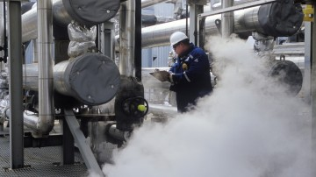
In-situ methods
Two main methods:
Steam assisted gravity drainage (SAGD)
Cyclic steam simulation
Oil sands industry uses 4% of the Western Canada Sedimentary Basin’s natural gas production
34 m³ of natural gas required to extract one barrel of bitumen from in-situ projects
EG5066 Energy Technologies: current issues & future directions

Slide 11
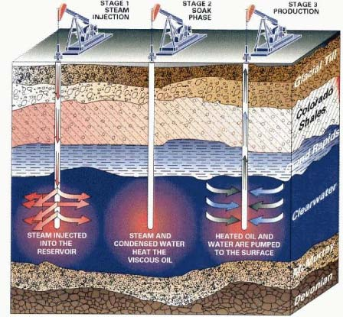
In-situ methods
Cyclic steam simulation – type of EOR
Inject steam into deep deposits to heat the sands and reduce bitumen viscosity so can be pumped like conventional oil
aka “huff and puff” recovery
3 stages:
Steam injection at 300-350ºC for months
Soaking for days/weeks
Oil pumped out until oil flow slows then start cycle again
Recovery factor 20 – 25%
EG5066 Energy Technologies: current issues & future directions

Slide 12
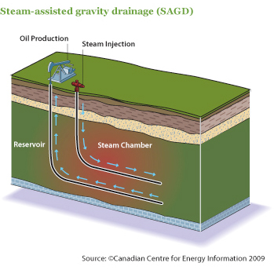
In-situ methods
Steam assisted gravity drainage (SAGD)
Developed in 1980s in Alberta
Pairs of horizontal wells drilled near base of deposit – 5m apart
Steam injected into well ~5m above producer well
Steam rises and heats bitumen & reduces its viscosity
Bitumen flows down under gravity to lower producer well from which it is pumped to the surface
Recovery rate 60 – 70%
EG5066 Energy Technologies: current issues & future directions

Slide 13
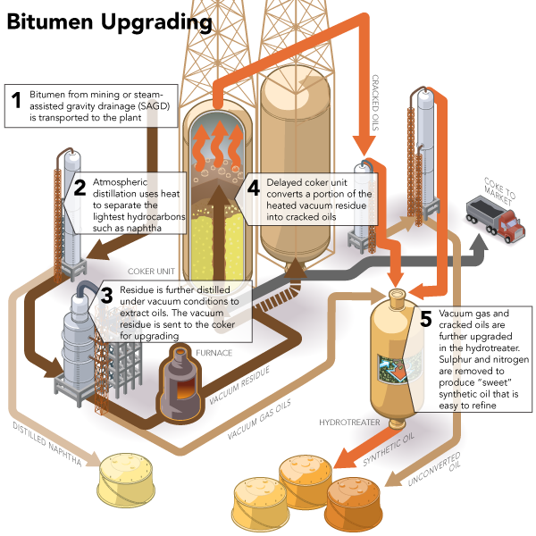
Upgrading
Heavy oils need to be upgraded before they can go to conventional refineries.
4 Main steps:
Thermal conversion or coking to crack the long hydrocarbon molecules
Catalytic conversion breaks down oil into smaller hydrocarbons using high pressure hydrogen
Semi-refined bitumen is distilled in a fractionating tower
Gas oils, kerosene & naptha hydrotreated with high temperature & pressure hydrogen to stabilise the hydrocarbons and remove impurities
EG5066 Energy Technologies: current issues & future directions

Slide 14
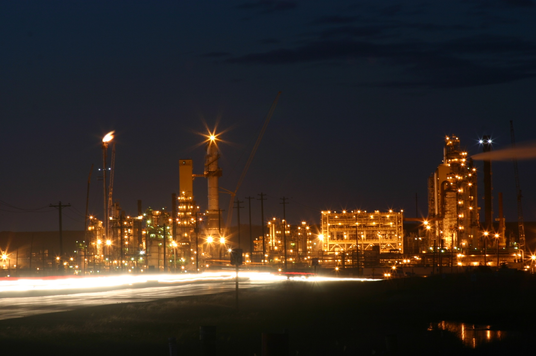
Bitumen processing
Bitumen diluted and then hydrogenated to produce Syncrude
Shell’s Scotford Upgrader
100,000 bbl/d (16,000 m³/d)
25% of Canada’s liquid fuel requirements
Takes clean bitumen from Muskeg river mine
Uses hydrogen, produced on site, to produce refinery-ready sweet, light crude oil called Syncrude
Syncrude upgrader plant
EG5066 Energy Technologies: current issues & future directions

Slide 15

Oil Sands
EG5066 Energy Technologies: current issues & future directions

Slide 16
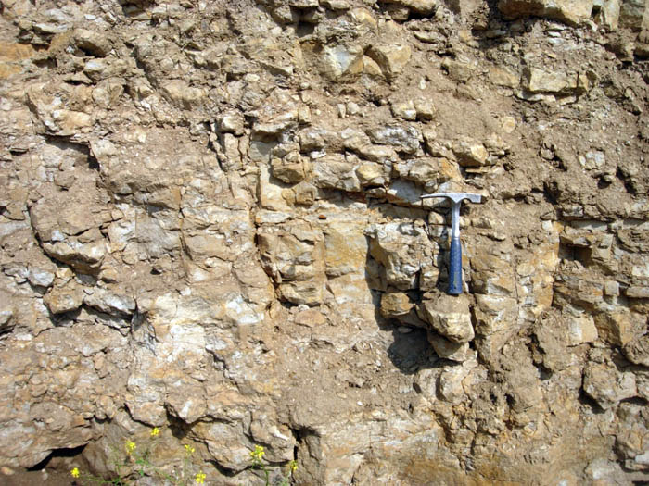

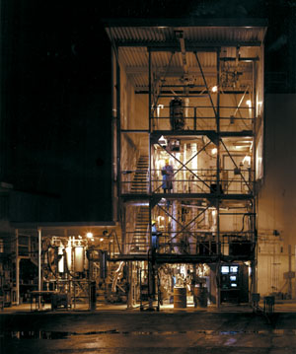
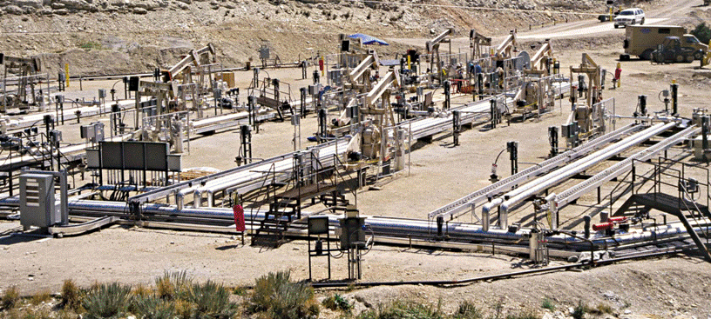
Shale Oil
Shale oil retort
EG5066 Energy Technologies: current issues & future directions

Slide 17
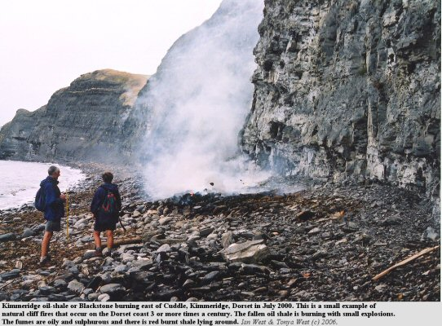
Shale Oil
Shale
A fine grained kerogen-rich sedimentary rock produced by the consolidation of clay, silt or mud, and composed roughly of:
33% Quartz
33% clay materials
33% other + organic matter
Oil Shale
A group of fine black to dark brown shales rich enough in bituminous material (kerogen) to yield oil upon heating in a retort
Shale gas
Natural gas produced from reservoirs predominantly composed of shale with lesser amounts of other fine grained rocks, rather than from more conventional sandstone or limestone reservoirs
EG5066 Energy Technologies: current issues & future directions

Slide 18
Shale Oil
Unconventional oil produced from oil shale by:
Pyrolysis
Hydrogenation
Thermal dissolution
Converts organic matter (kerogen) in rock into synthetic oil & gas
Ratio of shale gas to shale oil depends on retorting temperature and increases with rise in temperature 300 – 480ºC
EG5066 Energy Technologies: current issues & future directions

Slide 19
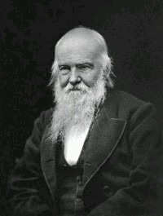
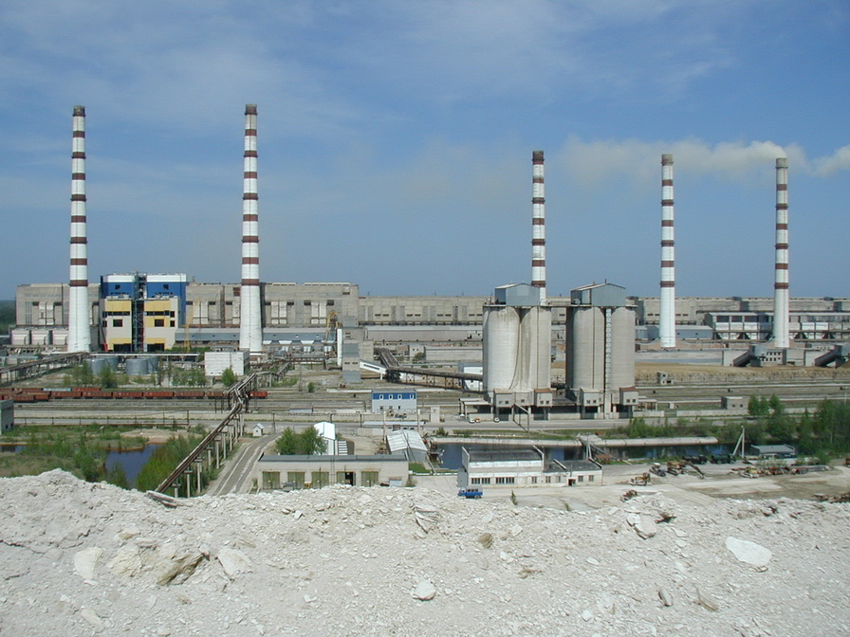
Shale Oil
Used since ancient times as it burns without any processing
Rock oil used for road construction and architectural adhesives
Early 1300 in Austria shale oil produced by an early retorting method of heating crushed oil shale in crucibles
17th Century Modena used shale oil to light streets
1837 – first industrial scale use in France – used Salligue process
1847 – James “Paraffin” Young made “lighting oil” from cannel coal
1859 – Commercial scale shale oil extraction started by Robert Bell in Broxburn
19th Century focused on kerosene, lamp oil and paraffin
1916 Beginning of Estonian oil shale industry
1924 – Tallin Power Plant 1st power plant using oil shale as primary fuel
2005 China became world’s largest shale oil producer
EG5066 Energy Technologies: current issues & future directions

Slide 20
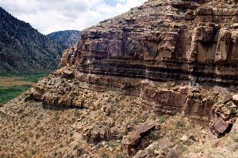
Resources
Deposits range from small presently non-economic to large commercially-extractable reserves
Defining reserves difficult due to variation in:
Chemical composition
Kerogen content
Extraction technologies
2005 Global estimates 2.8 – 3.3 trillion barrels of recoverable oil
600 shale deposits known
USA + Russia + Brazil have 86% of the reserves
EG5066 Energy Technologies: current issues & future directions

Slide 21
Resources (2006)
Deposit | Country | In place shale oil deposits (million barrels) | In place shale oil deposits (million tonnes)
Green River Formation | USA | 1,466,000 | 213,000
Phosphoria Formation | USA | 250,000 | 35,775
Olenyok Basin | Russia | 167,715 | 24,000
Congo | DR Congo | 100,000 | 14,310
EG5066 Energy Technologies: current issues & future directions

Slide 22
Resources - 2008
Region | In place shale oil deposits (million barrels) | In place shale oil deposits (million tonnes)
Africa | 159,243 | 23,317
Asia | 45,894 | 6,562
Europe | 368,156 | 52,845
Middle East | 38,172 | 5,792
North America | 2,100,469 | 383,758
Oceania | 31,729 | 4,534
South America | 82,421 | 11,794
World | 2,826,103 | 408,602
EG5066 Energy Technologies: current issues & future directions

Slide 23
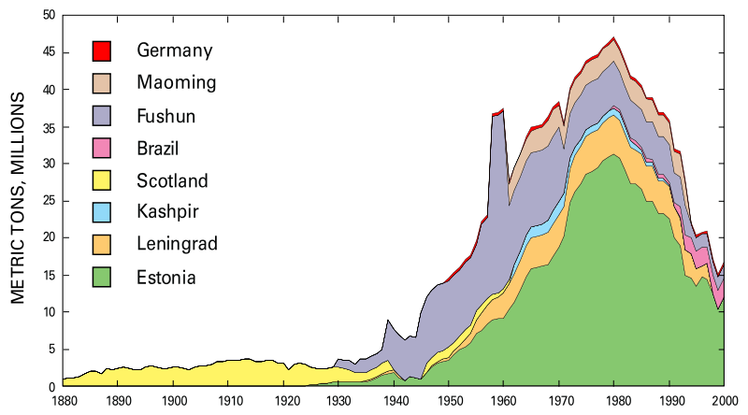
Shale Oil
Shale oil extraction
EG5066 Energy Technologies: current issues & future directions

Slide 24
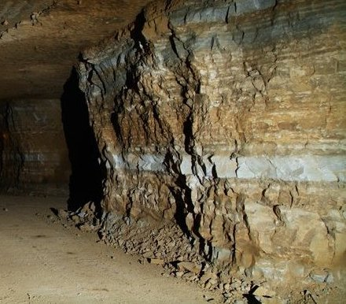
Shale Oil Extraction
Oil from shale cannot be obtained by drilling bore-holes
Earliest description of process in 10th Century
1684 – GB granted first formal process patent
Extraction industries widespread in 19th Century
2010 – major extraction industries running in Estonia, Brazil & China
Two main methods:
Ex-situ Mining and processing
In-situ combustion
EG5066 Energy Technologies: current issues & future directions

Slide 25
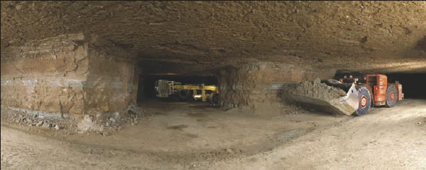
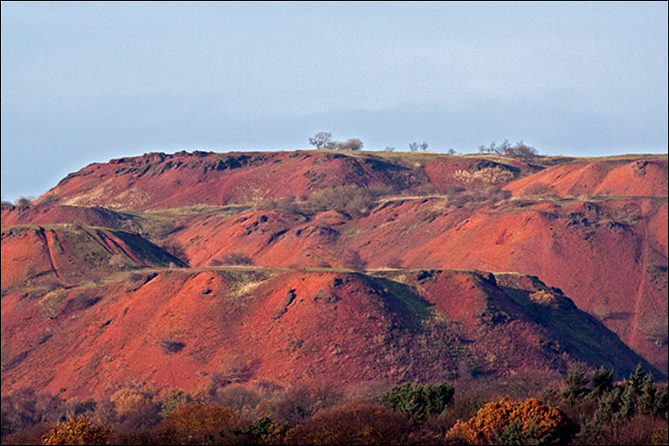
Shale Oil Extraction
Oil Shale Mining
Not usually open-cast mining – have to use sub-surface mining just as in the coal mining industry - e.g. room & pillar
100t crushed rock gives 90t waste
Volume of waste 40% greater than that of original rock
1 barrel of oil/t rock requires 5X more mining than coal
3 barrels of water for each barrel of oil
EG5066 Energy Technologies: current issues & future directions

Slide 26
Processes in Mining and Surface Retorting
Mining and crushing
Retorting
Oil upgrading
Oil to refinery
Spent shale disposal on site
Reclamation
EG5066 Energy Technologies: current issues & future directions

Slide 27
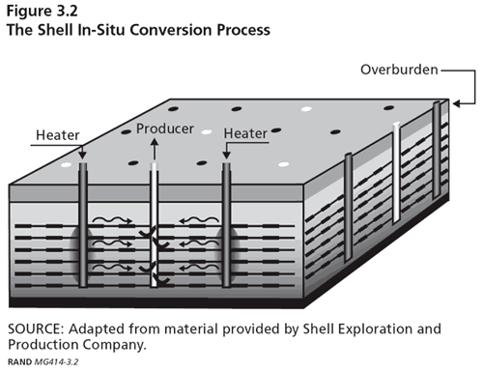
Shale Oil Extraction
Steps in thermally conductive in-situ conversion
Drilling and site preparation
Heating and production
Oil to refinery
Post production clean-up
EG5066 Energy Technologies: current issues & future directions

Slide 28
Shale Oil
Oil Shale Deposit
In-situ
Ex-situ
Fracturing
Mining
Retorting
Crushing
Product Recovery
Retorting
Thermal & Chemical Treating
Hydrogenation
Refining
Spent Shale
Liquid Fuels
By-products
EG5066 Energy Technologies: current issues & future directions

Slide 29
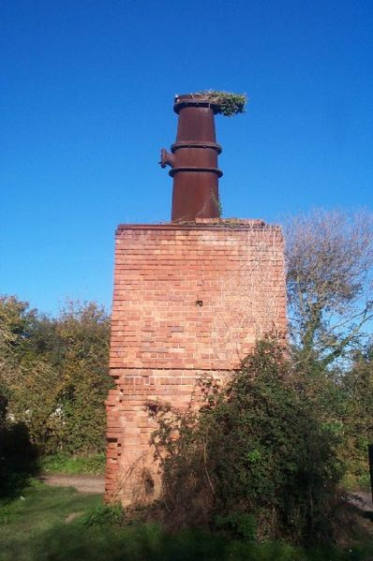
Shale Oil Extraction
Ex-situ processing
Extracted oil-bearing shale crushed (12 – 75 mm) and heated to ~ 500ºC
Kerogen condenses to viscous shale oil containing 80% of the original energy in the kerogen
Contains nitrogen compounds and sulphur that need to be removed
Combustion technologies burn the shale within a vertical retort to supply heat for pyrolysis.
Raw shale fed into the top of the retort and heated by the rising hot gases
Condensed shale oil is collected
Non-condensable gas recycled and used as heat carrier
In lower part of retort spent oil shale is heated to about 900ºC to burn off char
Shale oil retort in Somerset
EG5066 Energy Technologies: current issues & future directions

Slide 30
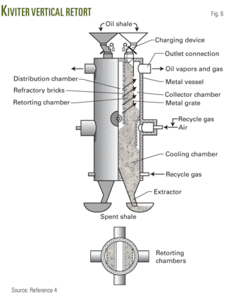
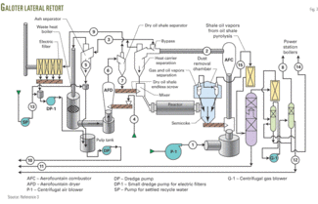
Oil Shale Retorting Technologies
There are hundreds of patents for oil shale retorting
Only a few undergone thorough testing
4 main technologies in commercial use
Kiviter - used in Estonia
Galoter - used in Estonia
Fushun – used in China
Petrosix – used in Brazil
EG5066 Energy Technologies: current issues & future directions

Slide 31
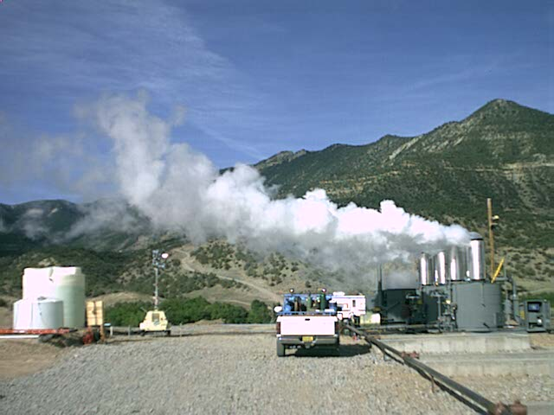
Shale Oil Extraction
In-situ technologies
Oil shale is heated underground by injection of hot fluids into the oil shale formation
Shale oil recovered through vertical wells drilled into the oil shale formation
Potentially able to extract more shale oil than conventional ex-situ processing technologies as wells can reach greater depths than surface mines
Can be used with lower grade deposits
One of the earliest in-situ technologies was the underground gasification by electrical energy (Ljungstrom method)
Newest technologies utilise different heat sources and heat delivery systems
EG5066 Energy Technologies: current issues & future directions

Slide 32
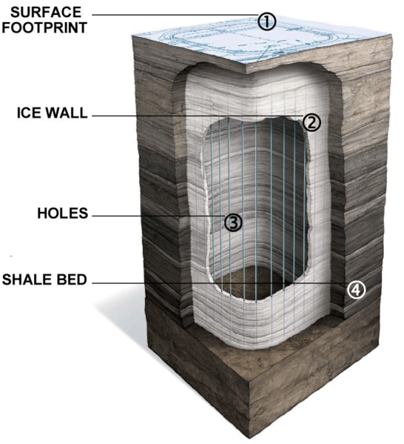
Shale Oil Extraction
Wall conduction
Use heating elements or heating pipes placed in the oil shale formation
Shell ICP process uses electrical heating elements to heat the shale layer to 650-700ºC over approx 4 years
Processing area isolated from groundwater by a freeze wall consisting of well filled with a circulating super-chilled fluid
Disadvantages:
Costs of electricity, water use, risk of contaminating ground water
Tested in Piceance Basin in 1980s – 270m3 oil extracted from 9 x 12 m test site
EG5066 Energy Technologies: current issues & future directions

Slide 33
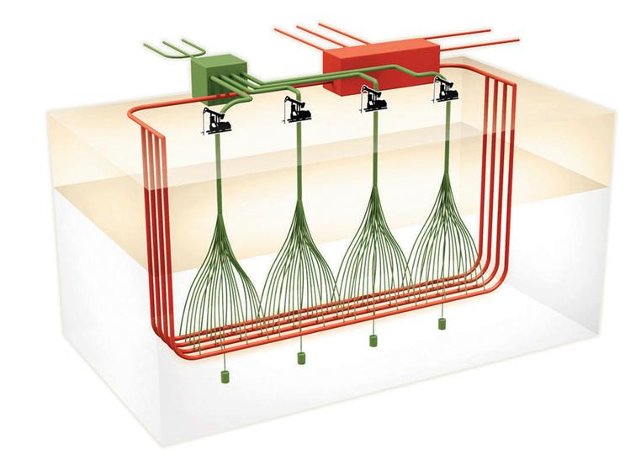
Shale Oil Extraction
American Shale Oil CCR process
Superheated steam circulated through a series of pipes placed below the oil shale layer to be extracted
System combines horizontal wells through which steam is passed and vertical wells which provide vertical heat transfer and a means to collect the hydrocarbons produced
Heat provided by combustion of natural gas initially and subsequently from oil shale gas
EG5066 Energy Technologies: current issues & future directions

Slide 34
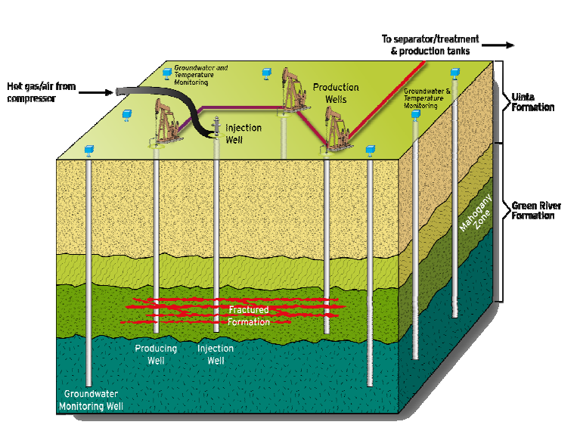
Shale Oil Extraction
Externally generated hot gas
Hot gases produced above ground and then injected into the formation
Chevron CRUSH process uses heated CO₂ injected into the well through drilled wells and then exposed to the formation through a series of horizontal fractures
EG5066 Energy Technologies: current issues & future directions

Slide 35
Power Generation
Oil shale burnt like coal to drive steam turbines
Country | Capacity (2012)
Estonia | 2,967MW
Israel | 12.5MW
China | 12MW
Germany | 9.9MW
Narva Power Plant, Estonia
EG5066 Energy Technologies: current issues & future directions

Slide 36
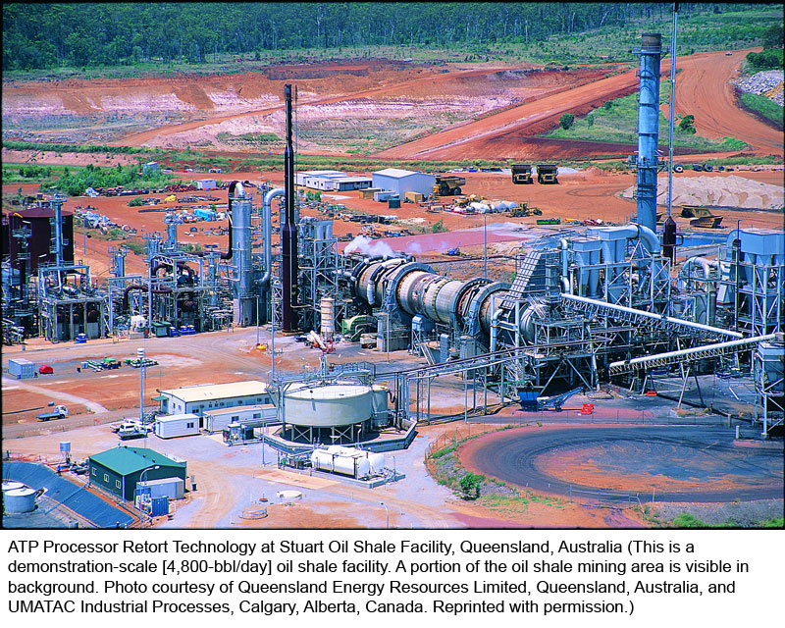
Shale Gas
EG5066 Energy Technologies: current issues & future directions

Slide 37
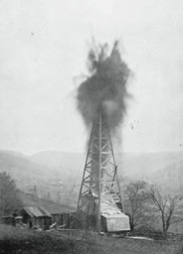
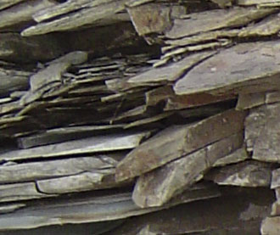
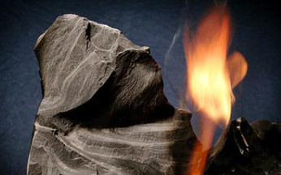
Shale Gas
Natural gas from shale
First commercial gas well drilled in Fredonia, USA in 1821
Shale gas well - 8.2m deep dug by hand
Fredonia, New York - first natural gas lights
Overshadowed by oil following Drake oil well in 1859
Could supply up to 50% of natural gas produced in USA by 2020
Shale gas is a “potential game changer” – Rune Bjornson of Statoil in 2009
EG5066 Energy Technologies: current issues & future directions

Slide 38
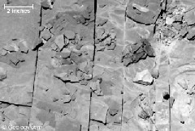
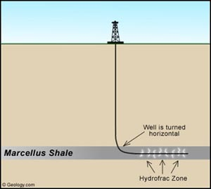
Shale Gas
Shales have insufficient permeability to allow significant fluid flow to a well bore
Shale gas occurs:
Within pore spaces
Within vertical fractures
Adsorbed on mineral grains and organic matter
Most shales are not commercial sources of natural gas
Significant commercial gas production from shale requires fractures to be created to give permeability
Shale oil boom due to development of:
Horizontal drilling
Hydraulic fracturing
EG5066 Energy Technologies: current issues & future directions

Slide 39


Shale Gas
Horizontal wells – cost $3-5million cf $800,00 for a vertical well
Hydraulic fracturing
Fluid pumped into well bore at sufficient pressure to create, propagate and maintain a fracture in the surrounding rock formation
Fluid is a slurry of water, proppants & chemical additives (0.5%)
EG5066 Energy Technologies: current issues & future directions

Slide 40


Shale Gas
Reserves
Significant reserves in USA – up to 100 years supply – 482tcf
Barnett Shale – 1.11 trillion cubic feet
Fayetteville shale
Marcellus Shale in the Appalachian region – a potential super giant field with 263 TCF reserves
Has 16% ethane so promoting new ethylene plants
Significant reserves in:
Canada
Europe
Estonia
Germany – Lower Saxony Basin
Hungary – Mako Trough
Sweden
UK – Weald Basin
EG5066 Energy Technologies: current issues & future directions

Slide 41

Shale Gas Resources
EG5066 Energy Technologies: current issues & future directions

Slide 42

Shale Gas Resources
EG5066 Energy Technologies: current issues & future directions

Slide 43

Oil Shale Gas
Synthetic gas mixture produced by pyrolysis of oil shale
Different from shale gas which is natural gas
Composition depends on technology and source of oil shale
Typically: CH₄, H₂, CO, CO₂, N₂, H₂S, ethylene
Substitute for natural gas – used as “town gas” in Tallin, Estonia
Used in a power plant in Kohtle-Jarve until 1987
EG5066 Energy Technologies: current issues & future directions

Slide 44



Methane clathrate
Methane clathrate aka:
Methane hydrate
Methane ice
A solid clathrate hydrate in which a large amount of methane is trapped within the crystal structure of water ice
Common constituents of the shallow marine geosphere:
In deep sedimentary structures
Outcrops on the ocean floor
Believed to form by:
migration of gas from depth along geological faults – precipitation or crystallisation on contact with cold sea water
Products of methanogenic bacteria on ocean floor crystallising with water
EG5066 Energy Technologies: current issues & future directions

Slide 45


Methane clathrate
Methane forms a structure I hydrate with two dodecahedral (20 vertices, thus 20 water molecules) and six tetradechedral (24 water molecules ) water cages per unit cell
Average composition is 1 mole of methane for every 5.75 moles of water
Density is around 0.9g/cm³
One litre of methane clathrate solid contains 168 litres of methane gas (at STP)
EG5066 Energy Technologies: current issues & future directions

Slide 46

Methane clathrate
Deposits
Restricted to shallow lithosphere (<2000m)
Polar continental sedimentary rocks where surface temperatures <0ºC
Oceanic sediment in water depths >300m where water temperature ~2ºC
Deep lakes – eg Baikal in Siberia
Size of deposits difficult to determine
EG5066 Energy Technologies: current issues & future directions

Slide 47

Methane clathrate
EG5066 Energy Technologies: current issues & future directions

Slide 48
Methane clathrate
Sedimentary methane hydrate reservoirs contain some 2-10 x known reserves of natural gas
Potentially important source of hydrocarbon fuel
Majority of deposits too dispersed for economic extraction
Large potential exploitable deposit in Gulf of Mexico 10¹⁰ m³ of gas
Need development of extraction technology in order to exploit reserves
Messoyakkha Gas Field near Norilsk in West Siberian Basin believed to be exploiting methane clathrates – it operates in a permafrost region
Large R&D programmes in Japan and China
EG5066 Energy Technologies: current issues & future directions

Slide 49


Methane clathrate
Test project in 2008 at the Mallik gas hydrate field in the Mackenzie River delta – gas extracted by lowering the pressure rather than using heat
Mallik gas hydrate field first discovered by Imperial Oil in 1971-72.
EG5066 Energy Technologies: current issues & future directions

Slide 50




Methane clathrate
EG5066 Energy Technologies: current issues & future directions

